Slide 1
Tuberculosis Drugs
Spreadsheet Documentation

Slide 2
General Information
Link to spreadsheet: https://docs.google.com/a/binghamton.edu/spreadsheet/ccc?key=0Ag8gS12PpxX2dF82NS1CLVhwd1RDSjhiMnFpdGtUZVE&usp=drive_web#gid=1
Spreadsheet contains data regarding
Summary of company rankings
WHO groupings and country categorizations
The burden of Malaria and the data of its drugs by countries
The burden of TB and the data of its drugs by countries
The burden of HIV and the data of its drugs by countries

Slide 3
Tab (1) Summary of Company Rankings
List of pharmaceutical companies, their drugs and target diseases
Ranking of the companies’ total impact scores:
Total impact scores = Need (DALYs lost) * Access (Treatment coverage) * Efficacy
Ranking of the companies break down by diseases
Total DALYs alleviated in different diseases break down by WHO regions

Slide 4
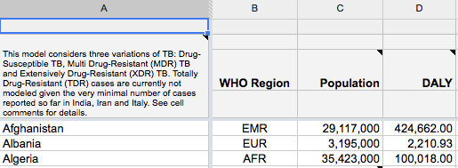
Tab (4) Tuberculosis by Countries
General information
Column A: List countries
Column B: Countries sorted by WHO regions
Column C: population
Column D: DALYs lost to TB break down by countries (2010 data)

Slide 5
Tab (4) Tuberculosis by Countries
Different kinds of TB
Drug-susceptible (Normal) TB
Multiple drug resistant (MDR) TB
Extreme drug resistant (XDR) TB
TB and HIV
All TB Incident Cases
Drug-Susceptible ("Normal") active TB
HIV+
HIV-
MDR-TB
XDR-TB

Slide 6

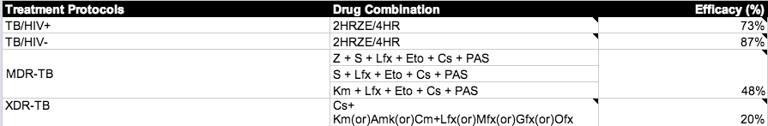
Tab (4) TB regimens and treatment protocols
Column G & H and Row 41-90: Standard treatment protocols
G129 to I134: Drug-resistant treatment protocols

Slide 7
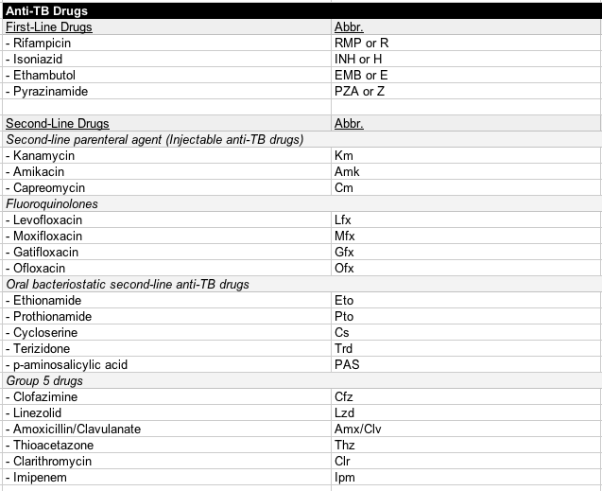
Tab (4) List of Anti-TB drugs
G142 to I171: List of Anti-TB drugs

Slide 8
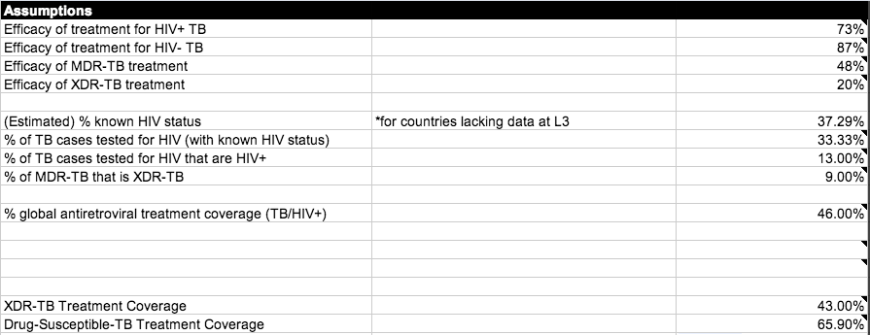
Tab (4) Tuberculosis Assumptions
Column J & K / Row 22-45: Assumptions

Slide 9
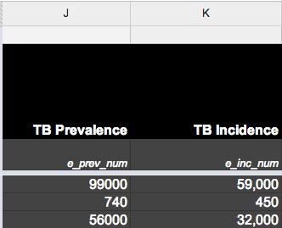
Tab (4) Prevalent and incidence cases
Column J and K: TB prevalence and incidence by countries
Prevalence: The total number of cases of disease existing in a population
Incidence: The total number of newly diagnosed cases of a disease

Slide 10
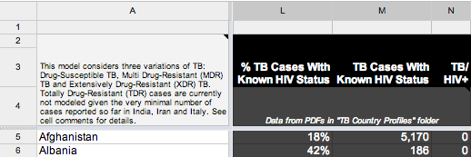
Tab (4) HIV Status
Column L: The percent of TB cases with a known HIV status, according to the WHO
Column M: The number of TB cases with known HIV status (WHO)
Column N: Number of cases that are TB/HIV+

Slide 11
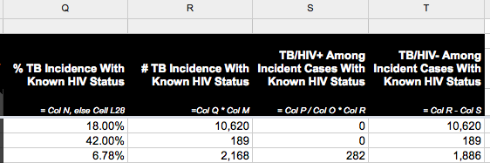
Tab (4) Prevalent and incidence cases
Column O-R:
Incident cases of active TB with HIV+/HIV-
% of active TB with HIV+/HIV- = The number of active TB with HIV+ or HIV- / The number of TB incidence with known HIV status.

Slide 12
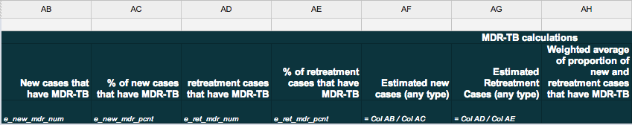
Calculating Impact Score: MDR-TB
DALYs lost to MDR-TB by country
Column AB-AH: Calculating proportion of cases that have MDR-TB (column AH)
AD/AE= AG
AB/AC = AF
(AB+AD) / (AF+AG) = AH

Slide 13
Calculating Impact Score: MDR-TB
#MDR-TB needing treatment (AI) = TB prevalence (J) * proportion of new and retreatment cases that have MDR-TB (AH)
DALYs lost to MDR-TB (AL) = Total DALYs lost to TB (D) * MDT-TB proportion (AH) – DALYs lost to XDR-TB (AQ)
Treatment Coverage of MDR-TB by country (AK) = # MDR-TB receiving treatment (AJ) / # MDR-TB needing treatment (AI)
Treatment Efficacy of MDR-TB (I25): Assumption
AK: Impact of MDR-TB treatment regimen = Need (DALYs lost to MDR-TB (AL)) * MDR-TB treatment coverage (AJ) * MDR-TB treatment efficacy (L25)

Slide 14

Calculating Impact Score: MDR-TB
The proportion of the impact each regimen in the MDR-TB treatment protocols is inversely proportional to resistance rates (G173-H178)

Slide 15
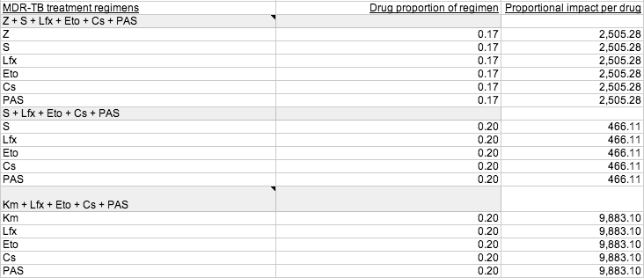
Calculating Impact Score: MDR-TB
Each drug within each regimen receives an equal proportion of that regimen’s impact (G47-I66)
A company’s total impact of MDR-TB regimen =

Slide 16
Calculating Impact Score: MDR-TB
A company’s total impact of XDR-TB regimen = The company’s proportion of credit for MDR-TB treatment (based on the sum of the anti-MDR-TB drugs it produces) multiplied by the sum of impact of MDR-TB treatment regimen in each country.

Slide 17
Calculating Impact Score: XDR-TB
DALYs lost to XDR-TB by country
Assumption I31: 9% of all MDR-TB cases are XDR-TB (WHO 2013)
DALYs lost to XDR-TB (AQ) = Total DALYs lost to MDR-TB (D) * MDR-TB proportion (AH) * 9%
XDR-TB Treatment Coverage (AP) = 43% (assumption I38)
XDR-TB treatment Efficacy (I26) = 20% (assumption I26)
Impact of XDR-TB treatment regimen (AR) = Need (DALYs lost to XDR-TB (AQ)) * XDR-TB treatment coverage (AP) * XDR-TB treatment efficacy (I26)

Slide 18

Calculating Impact Score: XDR-TB
The total impact of XDR-TB treatment is divided according to XDR-TB treatment protocols (G86-I91)
A company’s total impact of XDR-TB regimen = The company’s proportion of credit for XDR-TB treatment (based on the sum of the anti-XDR-TB drugs it produces) multiplied by the sum of impact of XDR-TB treatment regimen in each country.

Slide 19
Calculating Impact Score: Normal TB – Needs
Total DALYs lost to normal TB (U) = Total DALYs lost to TB (D) – the DALYs lost to MDR-TB (AL) – the DALYs lost to XDR-TB (AQ)
AU: DALYs lost to TB/HIV+ (V) = total DALYs lost to normal TB (U) * % TB/HIV+ (S)
AV: DALYs lost to TB/HIV- (W)= total DALYs lost to normal TB (U) * % TB/HIV- (T)

Slide 20
Calculating Impact Score: Normal TB – Access and Efficacy
Treatment coverage for TB/HIV+ (X) = 65.9% (Assumption about drug-susceptible TB treatment coverage (I39))
Treatment coverage for TB/HIV- (Y) = 65.9% (Assumption about drug-susceptible TB treatment coverage (I39))
Treatment Efficacy of TB/HIV+ (I23): 73% (assumption I23)
Treatment Efficacy of TB/HIV- (I24): 87% (assumption I24)

Slide 21
Calculating Impact Score: Normal TB
Impact of TB/HIV+ treatment regimen (Z) = DALYs lost to TB/HIV+ (V) * Treatment coverage for active TB/HIV+ (X) * Treatment efficacy for TB/HIV+ (I23)
BF: Impact of TB/HIV- treatment regimen (AA) = DALYs lost to TB/HIV- (W) * Treatment coverage for active TB/HIV- (Y) * Treatment efficacy for TB/HIV- (I24)
A company’s total impact of normal TB regimen = The company’s proportion of credit for standard treatment multiplied by the sum of the impacts of the normal TB treatment regimen in each country.

Slide 22
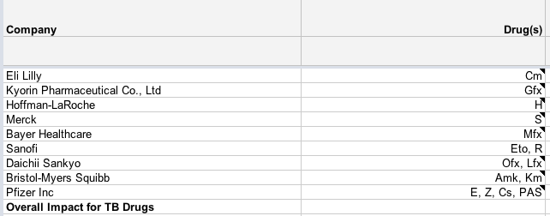
Calculating Impact Score by Companies
G5 to H13: Companies and their drugs
A company’s total impact score in TB = The sum of total impact score in treating normal TB, MDR-TB and XDR-TB

Slide 23
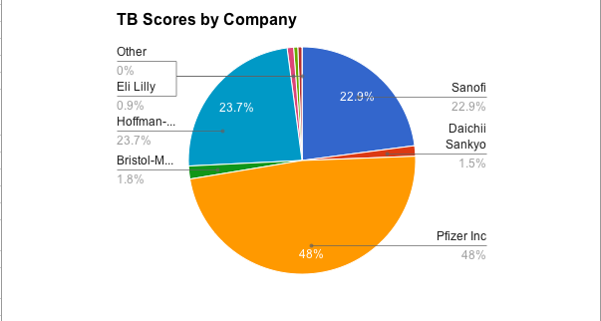
Total TB Impact Scores by Companies

